Slide 1

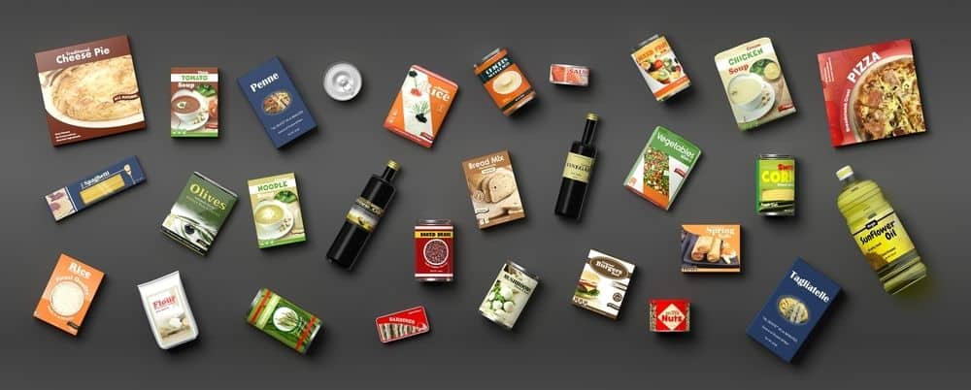
7
7
Indispensable
Food Packaging
Considerations
link-pack.com
Notes:
Note:
To Change the Background Picture Follow the steps below
Mouse Right button click>Format Background>Select Picture or Texture File>Click “File” button>Browse and select the image from your computer>Click Insert
That’s it. You are Done !!!

Slide 2
Food packaging is one of the most critical and often overlooked aspects of product development. We rely on food processing & packaging to transform and store our foods & beverages safely and hygienically and protect consumers. Food Packaging is designed to be durable and keep the public with a supply of efficient, informative & safe means of food conservation – conserving food quality throughout shelf life.
With the continued technological advances in the packaging industry, food processors can offer a multitude of options to their customers. In addition to providing better performance and production and using recyclable materials, machinery can usually operate multiple formats - making them more versatile than ever before.
This paper will discuss seven food packaging trends to keep in mind when choosing a product packaging or machinery supplier. Understanding these trends will help you decide on the right supplier for your food packaging needs.
LINK-PACK.COM

Slide 3
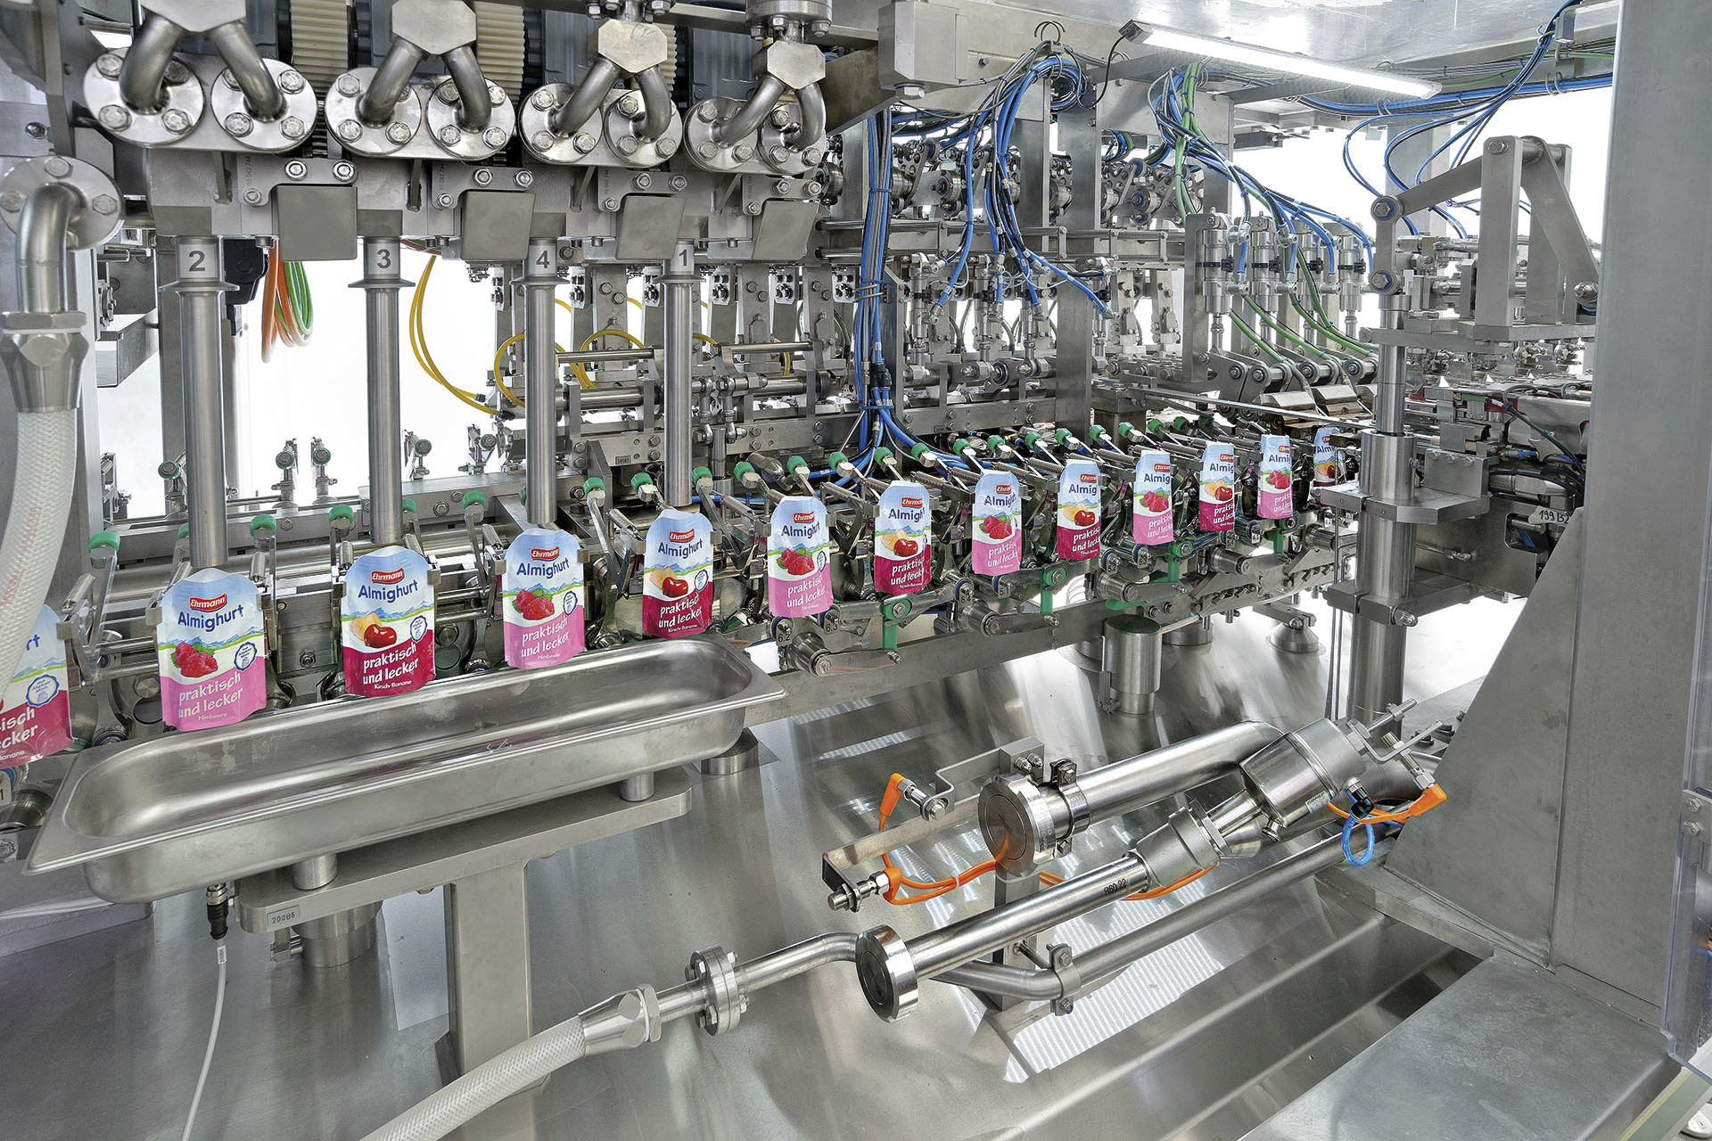
7 INDISPENSABLE
FOOD PACKAGING CONSIDERATIONS
Notes:
Note:
To Change the Background Picture Follow the steps below
Mouse Right button click>Format Background>Select Picture or Texture File>Click “File” button>Browse and select the image from your computer>Click Insert
That’s it. You are Done !!!

Slide 4
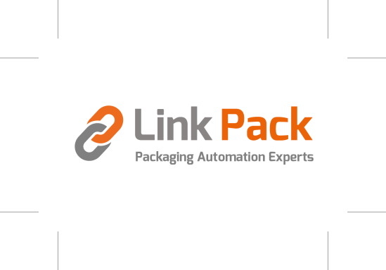
7 INDISPENSABLE
FOOD PACKAGING CONSIDERATIONS
1 - POPULARITY - How does the public view certain packaging types?
One of the most influential trends to consider when choosing food packaging is popularity. It is essential to target those types of packaging most in demand by consumers, whether through trendy design or health and wellness benefits. Proper targeting will help you avoid competition from other suppliers and ensure that your product remains popular long after its release.
There is no one-size-fits-all answer to this question, as the perception of packaging types can vary depending on the individual. Popular opinion leans toward biodegradable packaging being more environmentally friendly and heavier packaging being more long-lasting and resistant to damage. Others perceive transparent packaging as more aesthetically pleasing and make it easier to identify contents.
It is crucial for food and beverage companies to evaluate current industry trends before making purchasing decisions. Otherwise, they could find themselves dealing with outdated or non-competitive packaging suppliers in the not-so-distant future. Take a look at competitors' mistakes when choosing a package or machinery supplier to avoid common pitfalls.
Ultimately, it is essential to understand the consumer's perspective and cater your packaging to suit their preferences. If it isn't clear which packaging type will be the most popular for your product, do some research and speak with various packaging suppliers. There is undoubtedly a reason why that "original" type of packaging hasn't been used in the industry before. It might be an outdated or unsafe option for your product type. Purchasing decisions such as this can be overwhelming. However, with careful evaluation of consumer demand and competitor practices, your company will gain an advantage by staying ahead of trends before becoming popular in sales rankings.
‹#›

Slide 5
7 INDISPENSABLE
FOOD PACKAGING CONSIDERATIONS
2 - VISIBILITY - How will my package lend to visual impact?
Visual impact is the first and foremost impression your package will make, and it must provide the right message at the right time. When designing your product packaging, keep the target audience, the medium, and the message you want to communicate in mind.
The design should include elements that appeal to your target audience, like typography, color, and layout; these help consumers quickly identify and differentiate your product from others. It is well known that nearly 70% of shoppers' purchases are directly affected by packaging design & materials.
A key factor to consider when making packaging decisions is visual impact - what emotional response does it solicit? How will a brand and packaging type affect customer attraction or loyalty? If the packaging doesn't make that desired connection, likely, the customer will not make a purchase or buy a competing brand.
Creating meaningful and impactful package designs means taking all of the abovementioned factors into consideration.
In short, the quantity and quality of packaging styles continue to increase day by day. Packaging affects overall visibility for several reasons, notably the amount of space it occupies on the self, the available printing surface for graphics & information, and consumer preference regarding colors & materials. Among the best in terms of sheer size and design space would undoubtedly be stand-up pouches and cylindrical containers with labels that wrap the entire circumference. Every aspect should be tailored to suit the specific targeted audience or niche.
‹#›

Slide 6
7 INDISPENSABLE
FOOD PACKAGING CONSIDERATIONS
3 - SUSTAINABILITY - How does packaging affect the environment?
It is unavoidable that packaging has some kind of effect on the environment, whether good or bad. On the good side, efficient product packaging can save resources, including energy and paper. It is also possible to recycle and reuse more types of packaging than ever before - reducing the amount of waste produced.
On the other hand, inefficient and excessive product packaging leads to wastefulness and pollution. In particular, excessive use of plastic packaging can create vast quantities of waste that are difficult to manage and often end up in landfills or the ocean. Unfortunately, some packaging releases harmful chemicals into the environment when discarded or recycled, also causing damage to the environment.
To fully understand the extent of food packagings' environmental impact, evaluate it on the following criteria.
The materials used are probably the most significant consideration. When possible, opt for materials composed of recycled materials and those that are fully recyclable. Additionally, you will want to consider packaging compositions like biodegradable ingredients that are sure to be broken down sustainably. Countless sources suggest 25-35% of modern carbon emissions come from packaging. Another important consideration is how your finished product will be shipped. Any good global citizen needs to evaluate their choice's potential effects on the environment before putting it into mass production.
‹#›

Slide 7
7 INDISPENSABLE
FOOD PACKAGING CONSIDERATIONS
4 - MODULARITY - Will upgrades or modifications be achievable in the future?
For most companies' modularity means the ability to configure elements in a more tailored configuration. It permits economy of scale, optimal use of available floor space, and quick adaptation to quickly changing market conditions. It provides valuable benefits to producers who want to change or modify current packaging or package a completely new product. Even large multinationals like PepsiCo and Proctor and Gamble embrace modularity. They recognize that modularity provides producers with ease of production, optimization, and the engineering of marketing strategies for brand differentiation - essential to keep up with consumer trends.
Some of the most common machinery upgrades or modifications include new types of closure systems, printing and labeling capabilities, and tracking and tracing systems. By upgrading food packaging equipment, meeting industry requirements, production rates, and supply-chain logistics become efficient and safe.
The benefits of modular food packaging equipment include decreased production time, reduced packaging costs, improved hygiene and safety, and increased production efficiency. Here are four of the most common benefits:
1. Reduced production time - Automated food packaging equipment can help you produce food packaging in significantly less time than traditional methods allowing a reduced inventory and reduced cost of goods. Modularity will enable manufacturers to plan for upgrades according to space and budget.
2. Reduced packaging costs - The modularity of food packaging equipment means that you can customize the design and shape of your packaging line to fit changing requirements reducing packaging costs.
‹#›

Slide 8
7 INDISPENSABLE
FOOD PACKAGING CONSIDERATIONS
4 - MODULARITY - Will upgrades or modifications be achievable in the future?
3. Improved hygiene and safety - Modular food packaging equipment is often equipped with sanitizing and filtration systems that ensure high levels of hygiene and security of your products. This eliminates the need for separate processes for hygiene and safety, which can be time-consuming and expensive.
4. Increased production efficiency - Modular food packaging equipment provides the added flexibility to keep your production lines moving rapidly, quickly meet consumer demand and reduce the amount of time spent on manual tasks.
‹#›

Slide 9
7 INDISPENSABLE
FOOD PACKAGING CONSIDERATIONS
5 - LABOR - How will machinery affect my labor costs?
The use of automation and industrial equipment has been long believed to reduce the labor force, and while the effect on the workforce is real - it is not quite as harmful as workers might expect. In all actuality, the introduction of automated processing & packaging machinery increases product demand and competition, which directly impacts employment.
Companies that implement production automation are quick to expand sales and scale, leading to hiring additional operators and labor. The company saves on labor costs, and consumers save on the purchase price while workers benefit from a more diversified workday and lessened work-related injuries. These positive effects are most notable in sectors with international competition.
Additionally, packaging machinery is designed to minimize the use of materials and can also reduce the amount of waste produced, lowering the costs attributed to waste disposal while helping to protect the environment.
‹#›

Slide 10
7 INDISPENSABLE
FOOD PACKAGING CONSIDERATIONS
6 - HEALTH & SAFETY - How will my packaging affect health & safety?
Packaging is an essential part of the food industry, and it has a significant impact on health and safety. Poorly designed or packaged food can lead to adverse health effects, including food poisoning and food-borne allergies. In addition, poorly designed or executed packaging can also lead to environmental disasters.
Food packaging technology addresses specific food packaging needs, such as tamper-proof packaging, microwavable packaging, modified atmospheric packaging, and controlled atmospheric packaging, which enhance safety, quality, and convenience for the consumer.
The chemical composition and physical properties of different packaging types are crucial to evaluate on the following criteria: transportation, chemical reactivity, optical properties, and mechanical properties. Since the Pandemic disrupted, supply-chain delays have increased, and a huge focus has been placed on food preservation and traceability. It is common to add traceability technology to packaging labeling already used for marketing initiatives and messaging by upgrading your regular label paper with NFC enhanced label materials.
It is paramount to pay close attention to packaging design and construction to meet all safety and health standards.
‹#›

Slide 11
7 INDISPENSABLE
FOOD PACKAGING CONSIDERATIONS
7 - PRACTICALITY - How flexible will my machinery be?
Practicality & functionality rate high on the product packaging scale of considerations. Food packaging machines are generally designed to perform one or more specific tasks, such as sealing food products in airtight containers, filling and packing products into boxes or sacks, or creating labels and barcodes. So, while you don't need a machine that can run multiple formats, it is beneficial if lines with high production speeds handle various tasks and formats. Most automated food packaging machinery come with software allowing to customize the packaging formats processed. Straight forward automated machinery programmed to handle multiple "recipes" allows quick and easy changeovers, saving time and money.
‹#›

Slide 12
7 INDISPENSABLE
FOOD PACKAGING CONSIDERATIONS
8 - INFORMATIONAL - Can QR Codes or NFC chips be integrated into packaging?
QR Codes - short for Quick Response codes - are two-dimensional barcodes that can be scanned with a smartphone camera to reveal product details, prices, and contact information. They are increasingly integrated into product labels because they offer plenty of opportunities to the food and beverage sectors. They can be used to share nutritional information and alert to possible allergens. QR code technology also allows consumers to share a product journey from the farm or producer to the store. Overall they lend to brand transparency and credibility.
NFC (near field communication) chips - also known as contactless smart tags or RFID (radio frequency identification) tags - are small chips that can be embedded into products or packaging to automate transactions such as payments and authentication. They are popular in the retail and hospitality industries for various purposes such as tracking inventory, checking eligibility for discounts, or logging in to online accounts.
QR Codes and NFC chips can be printed or applied to packaging in diverse ways, including using a QR Code print service, a QR Code printer, or an NFC chip applicator.
QR Code print services allow printing on any paper or cardstock. It is the most simple and common way to print QR Codes. Upload your artwork, select the QR Code format, and specify the quantity you need.
QR Code printers are small devices that print on many materials, including paper, cardstock, labels, etc. They are a convenient option if printing QR Codes on a large scale or used in conjunction with other marketing initiatives.
NFC chip applicators apply NFC chips directly to packaging. They are easy to use and can be employed with various materials, including paper, cards, labels, and more.
‹#›

Slide 13
7 INDISPENSABLE
FOOD PACKAGING CONSIDERATIONS
8 - INFORMATIONAL - Can QR Codes or NFC chips be integrated into packaging?
When printing or applying QR Codes or NFC chips to packaging, be sure to use high-quality prints that will not fade or crack over time. Designs with QR Code or NFC chips should be created with end-use in mind, they should be easy to scan by a scanner. Please keep it simple with characters and designs that are easy to read. And finally, make sure to include your contact information so customers can reach you if they have any questions or problems scanning your codes or chips.
Food packaging is an indispensable aspect of product development, and it's crucial to select the right supplier for your needs. Staying informed of current trends makes it easier to decide on packaging options best suited to your business. It can be hard to keep track of everything with so many choices to make. That's where our packaging experts come in! By guiding you through the different options and implications, you'll be able to make informed decisions that will improve the quality, safety, and sustainability of your food products. Contact us now to get started!
‹#›

Slide 14
7 INDISPENSABLE
FOOD PACKAGING CONSIDERATIONS
CONCLUSION
We hope we have provided some insight and that you have gained some appreciation for the different aspects of the food & food packaging world.
While we have shared a great deal of information in this white paper, we know that every company's needs are different and that you may have unanswered questions. Please feel free to contact us and we will advise you in the most honest and transparent way possible.
‹#›

Slide 15

CONTACT
Jean-François Biron
438-988-1789
jbiron@link-pack.com
www.link-pack.com

